Slide 1
BWT Wodapure Kits
Emile Berries
May 2020

Slide 2
Agenda
1. Product Range
2. Technical Specifications
3. Woda-Pure Heads
4. Woda-Pure Kits
5. Installation Kits
6. Pricing

Slide 3
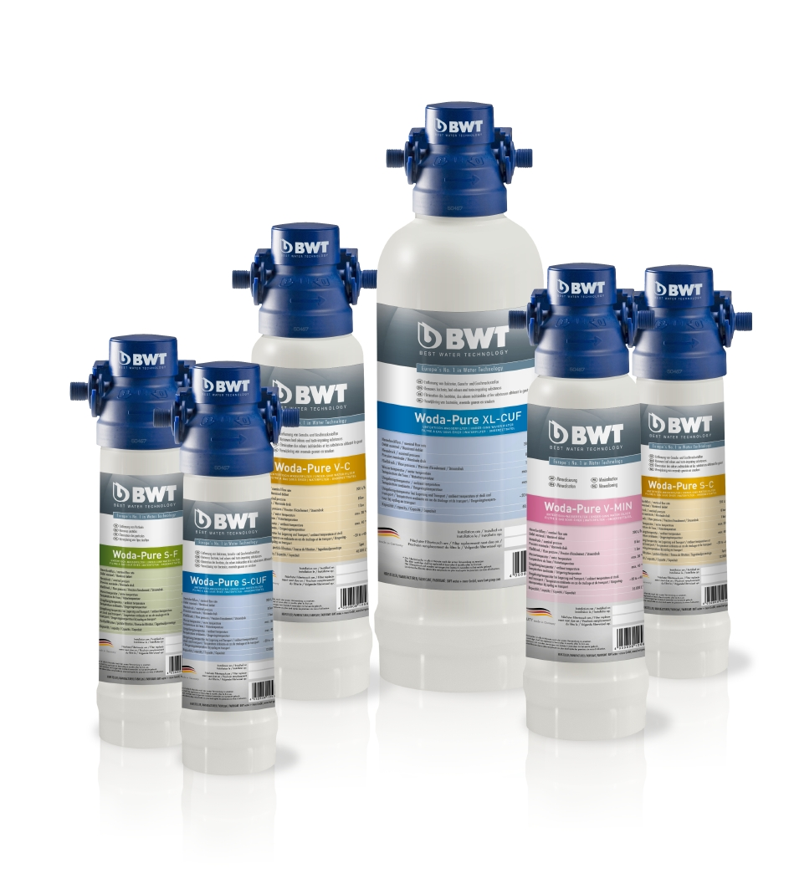
Woda-Pure

Slide 4
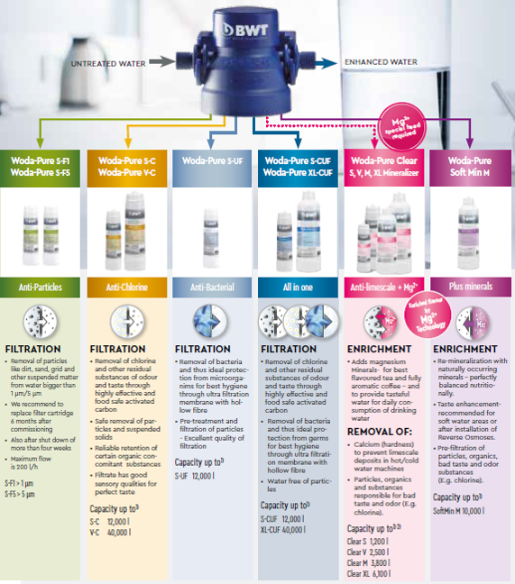
Woda-Pure Family

Slide 5
Woda-Pure S-F

Slide 6
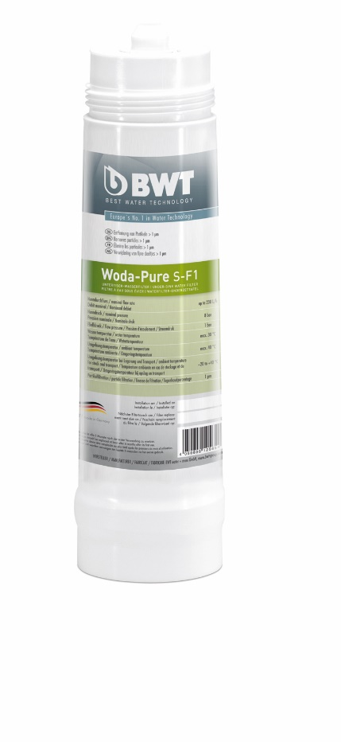
Woda-Pure S-F1 & 5
PROBLEM
Too many particles in the raw water
Fast blockage of the ultrafiltration membrane and other Woda-Pure filters like Woda-Pure S/C, V/C or Woda-Pure Clear
Blockage of valves
SOLUTION
Woda-Pure S-F1/S-F5 (used for removal of particles > 1 µm (F1) and > 5 µm (F5)
The filters are used as prefilters in combination with:
Woda-Pure S/XL - CUF or
Woda-Pure or V-C and/or
Woda-Pure S-UF

Slide 7
Technical Details
Water flows from the outside to the inside
No emit of particles!
 | S-F1 & S-F5
Capacity | dependent from the inlet water
Max. flow rate | 200 l/h
Pressure | max. 8bar
Replacement intervals | 6 months
Water temperature | max. 30°C
Ambient temperature | max. 40°C

Slide 8
Woda-Pure CUF

Slide 9
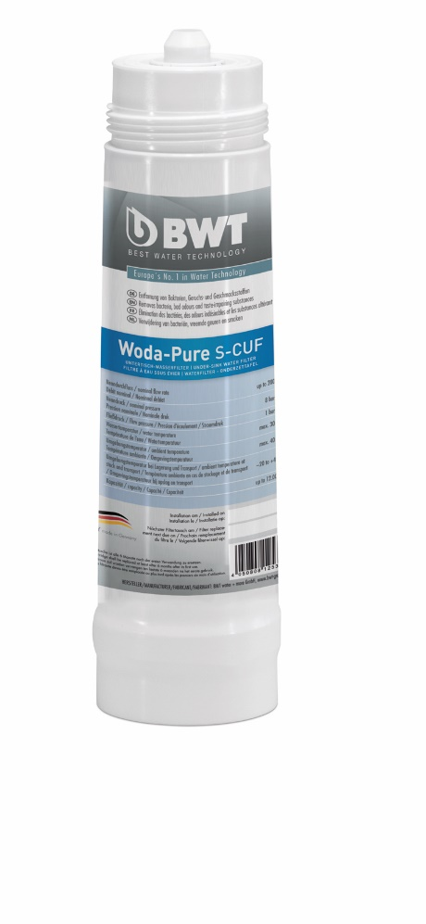
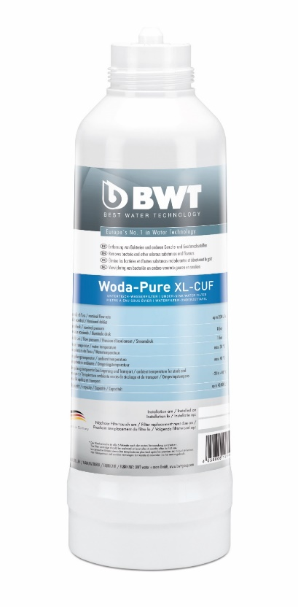
Woda-Pure S & XL-CUF
PROBLEM
Raw water with bad odours
Taste impairing substances (chlorine)
Particular organic substances (herbicides, insecticides)
Contamination with bacteria and protozoa
SOLUTION
Woda-Pure S-CUF and XL-CUF with a combination of activated carbon block and hollow fiber ultrafiltration membrane
Removal of bad odours and taste impairing substances
Removal of particular organic substances (herbicides, insecticides)
Removal of bacteria and protozea

Slide 10
Technical Details
start-up rinsing “over head” to get the air out / (5-10L or 1min)
40µm particle filter around the AC block
40µm adapter between AC and UF
Does not work well with pressure less taps
 | S-CUF | XL-CUF
Capacity | 12.000l | 40.000l
Max. flow rate | 200 l/h
Pressure | max. 8bar
Replacement intervals | 6 months
Water temperature | max. 30°C
Ambient temperature | max. 40°C

Slide 11
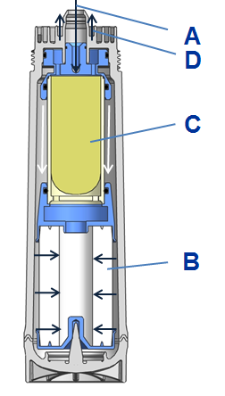
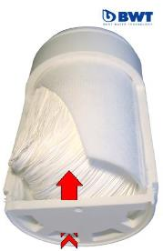
Technical Details
A Inlet tap water
B Particle Filter (20 µm)
C Hollow fiber ultrafiltration membrane
0.02 Micron
D Outlet filtered water

Slide 12
Woda-Pure Clear Mineralizer

Slide 13
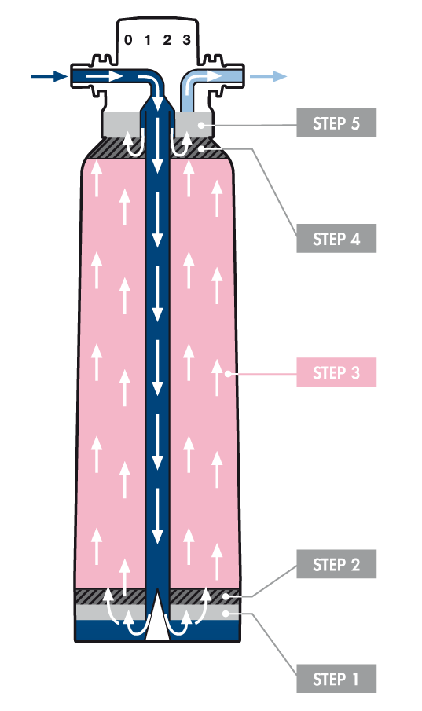
How does it work?
1
Pre-filtration
For particles, e.g. sand, grit, rust
2
Activated carbon pre-filtration
For protection of the ion exchanger
3
High-performance ion exchanger
Limescale protection
Essential mineral magnesium is added to the water
Reduces heavy metals such as copper, lead, zinc and nickel
4
Activated carbon filtration
Eliminates unpleasant taste and odour, e.g. chlorine from the bypass water
5
Fine filtration
Captures even the finest particles
The result is clean and TASTY water!

Slide 14
Technical Details
Best solution for tea- and coffee machines – high lime scale protection!
High quality tap needed! – changed PH value can cause corrosion
Resin guarantees a bacteria protection (silver)
Water with <4°dH has almost no function
 | Clear S* | Clear V* | Clear M* | Clear XL*
Capacity @6°dH | 1.200l | 2.500l | 3.800l | 6.100l
Max. flow rate | 60 l/h
Pressure | max. 8bar
Replacement intervals | 6 months
Water temperature | max. 30°C
Ambient temperature | max. 40°C
*Suitable ONLY with BYPASS filter head #12580

Slide 15
Technical Details

Slide 16
Woda-Pure Filter Head

Slide 17
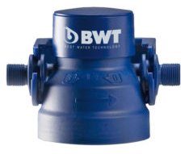
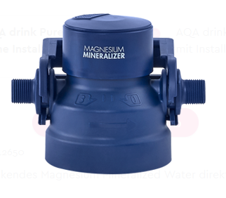
Woda-Pure Filter Head Unique features
With & without 4-stage Bypass (0, 1, 2, 3)
Backflow preventer
IN- and OUTLET with Aquastop
No need to close the water supply to replace the cartridge
3/8“ male thread IN- and OUTLET
Wide spectrum of international approvals

Slide 18
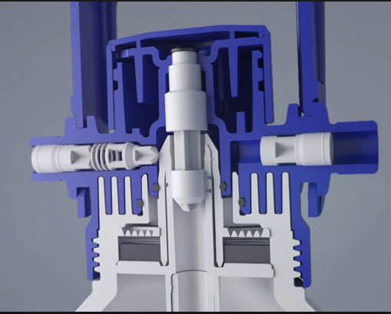
How does it work?
A – water inlet
B – back flow preventer
C – Aqua stop
D – Bypass settings
E – water outlet
A
B
C
B
E
D

Slide 19
Video

Slide 20
BWT Wodapure Kits

Slide 21
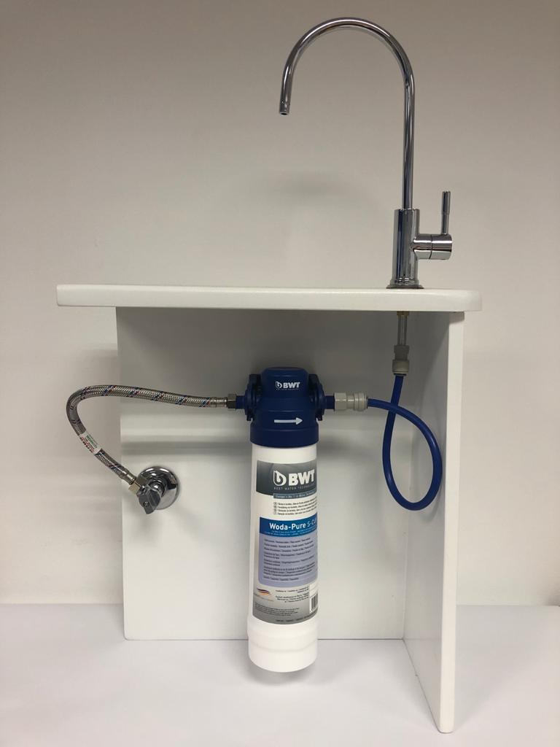
Woda I Bundle
Consist of the following:
1 x S-CUF
1 x Filter head
Excludes Faucet and Installation kit.

Slide 22
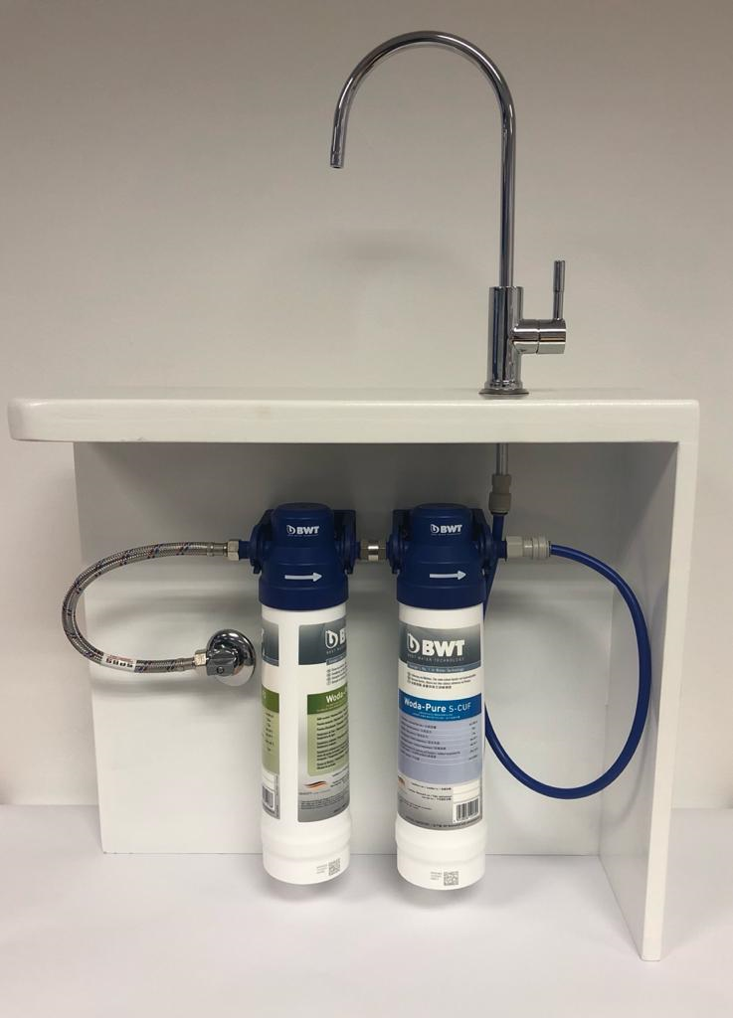
Woda II Bundle
Consist of the following:
1 x SF 5
1 x S-CUF
2 x Filter heads
1 x Connector
Excludes Faucet & Installation kit.

Slide 23
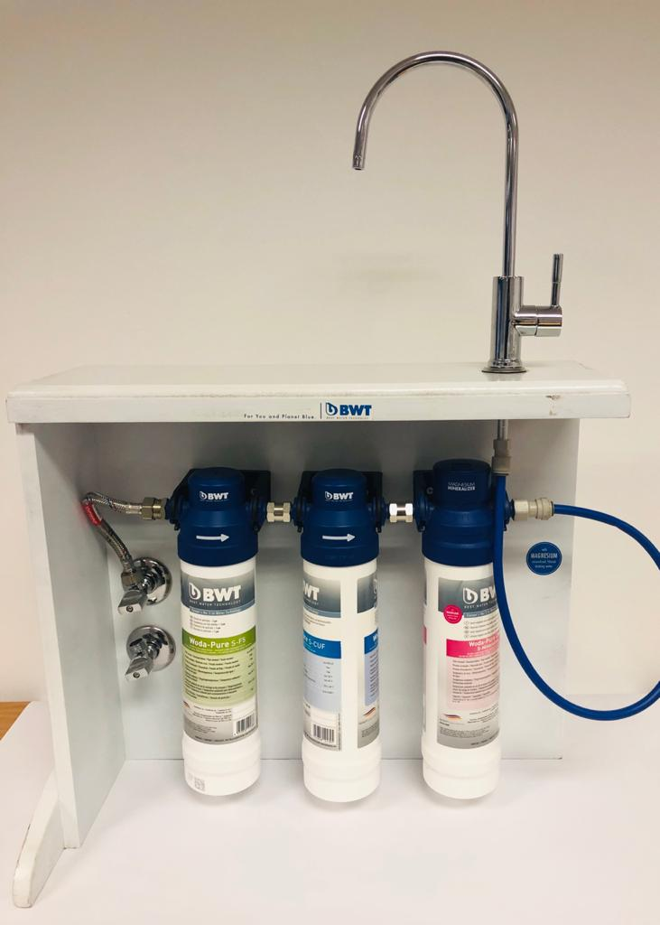
Woda III Bundle
Consist of the following:
1 x S-F5
1 x S-CUF
1 x Wodapure clear S
2 x Filter heads
1 x Mineralizer Head
2 x Connector
Excludes Faucet & Installation kit

Slide 24
Installation Kits

Slide 25
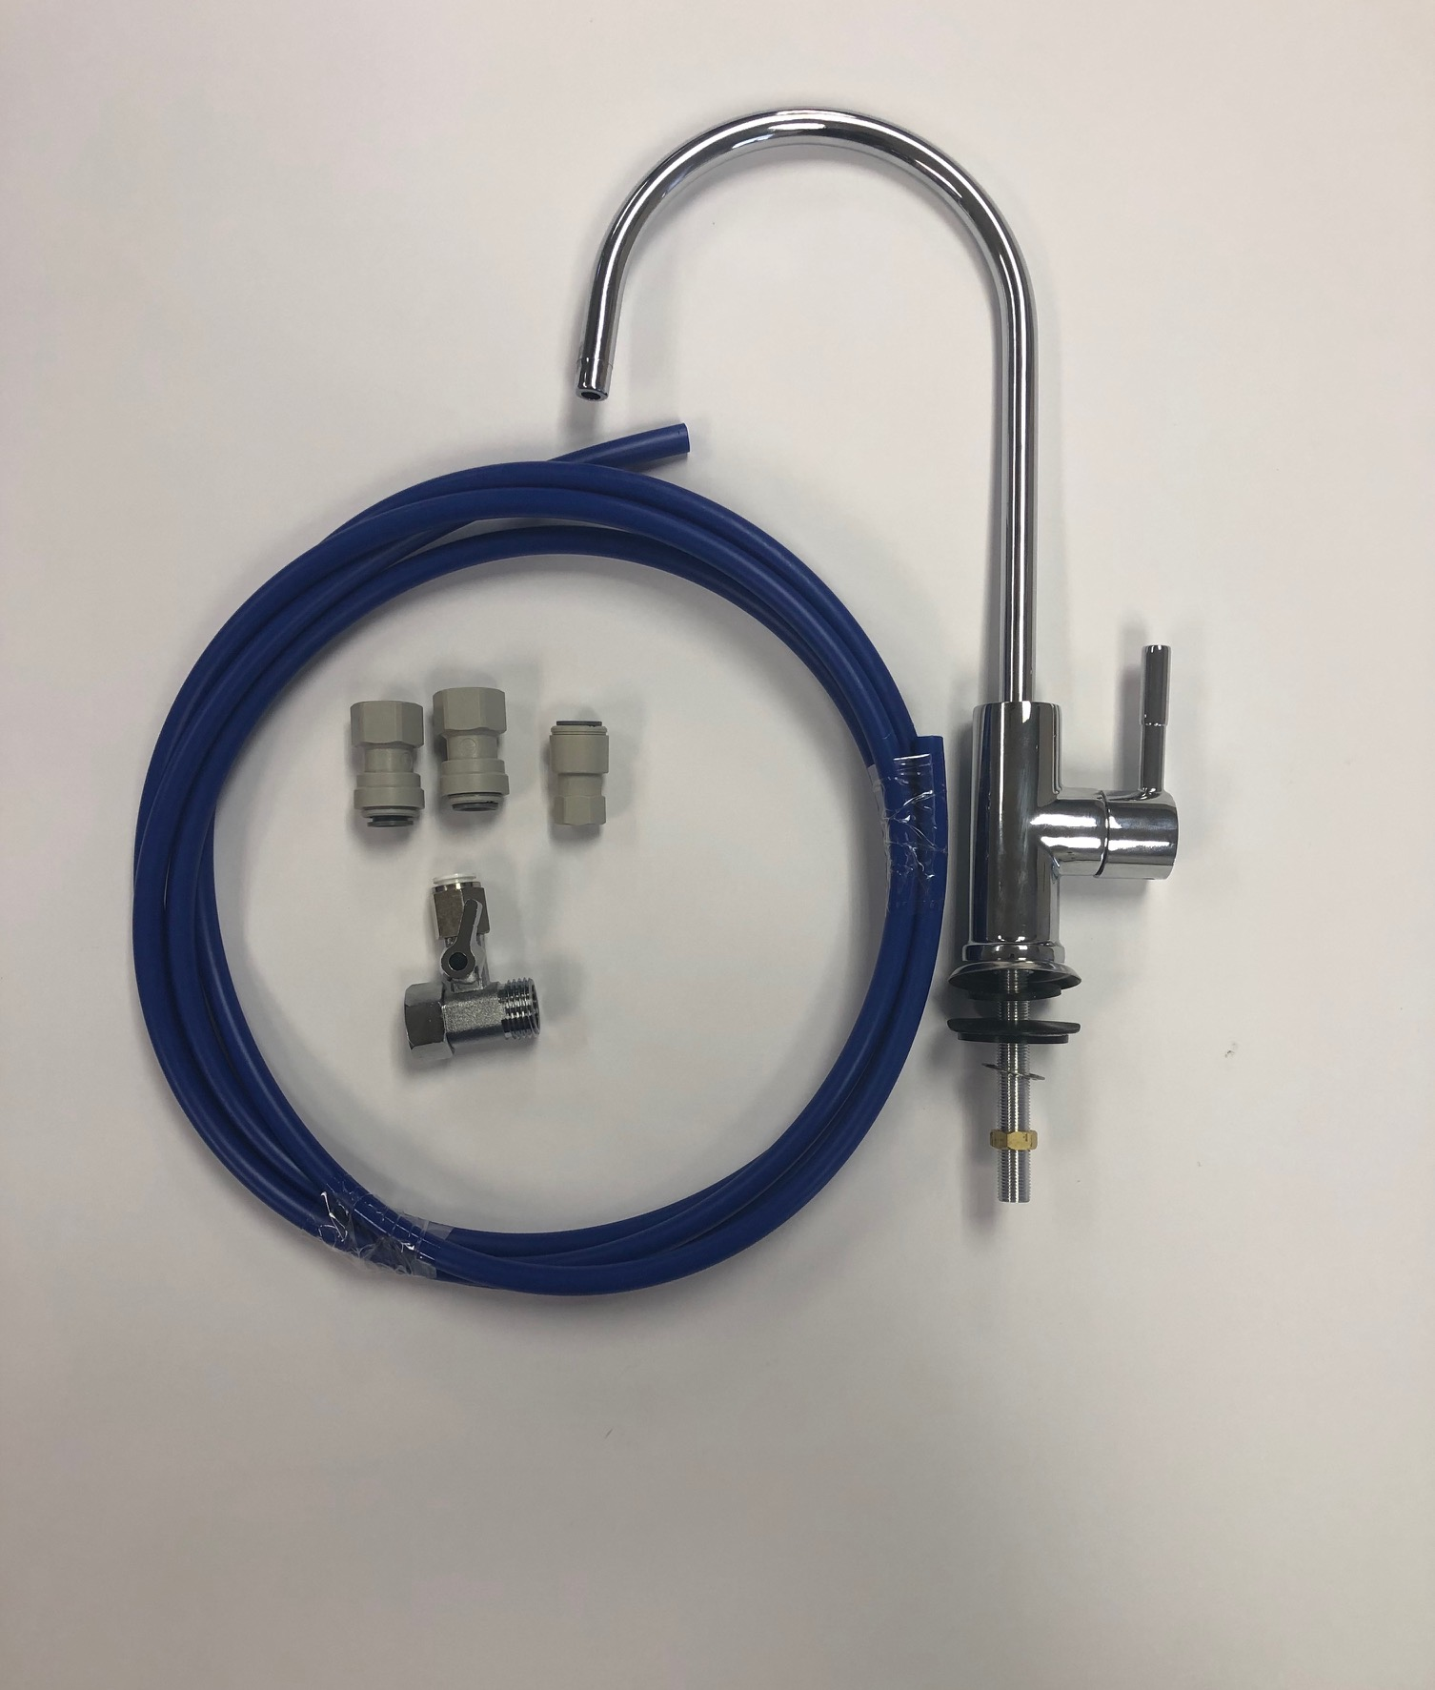
Faucet installation kit

Slide 26
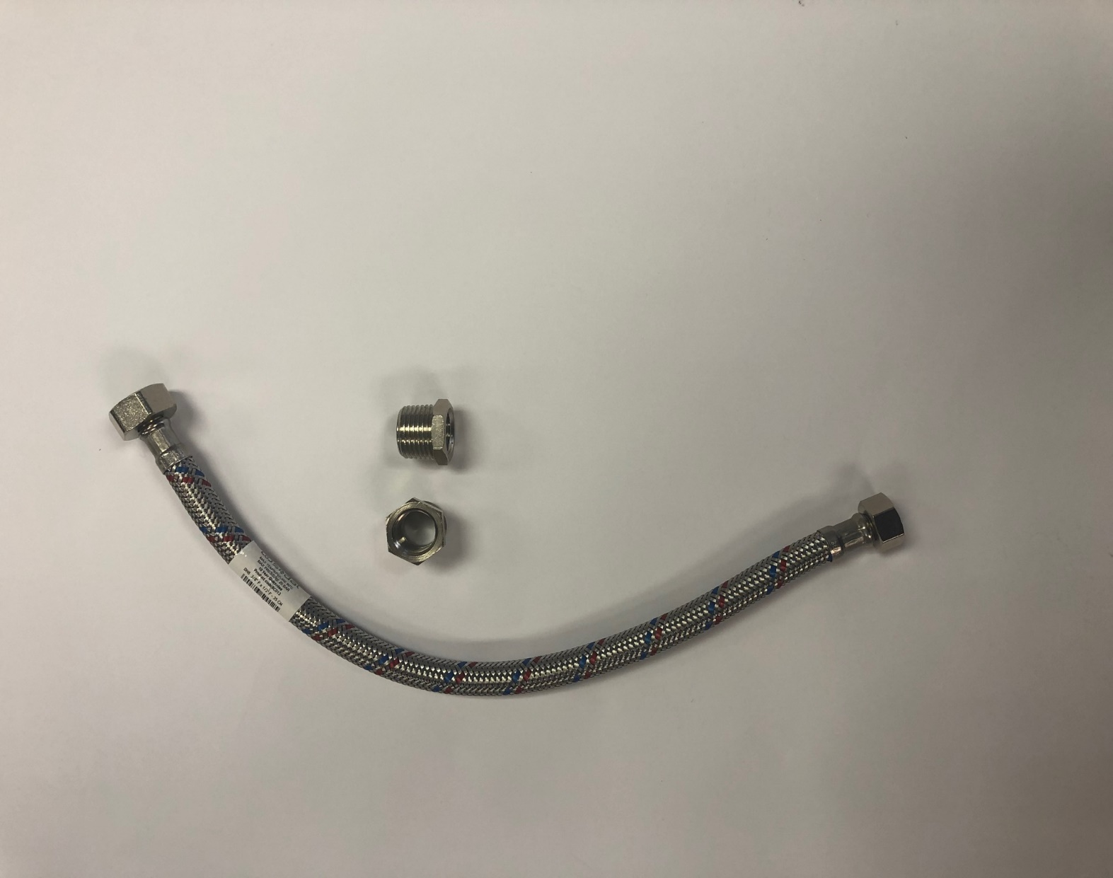
Inline installation kit

Slide 27
Pricing

Slide 28
Pricing
Product | G2G WAS | G2G Bundle NOW | RSP (Retail) WAS | RSP (Bundle) NOW
Woda I | R 1 582,04 | R 1 123,00 | R 2 799,00 | R 2 349,00
Woda II | R 2 478,56 | R 1 674,00 | R 4 386,00 | R 3 499,00
Woda III | R 3 789,26 | R 2 410,00 | R 7 375,00 | R 4 999,00
Faucet & kit | R 609,83 | R 589,70 | R 950,65 | R 898,00
Inline kit | R 132,89 | R 100,00 | R 201,00 | R 199,00
* To achieve the above G2G bundle prices we are supplying a free head with every cartridge purchased free!!!
* Also note that for the following two(2) months if you purchase any Woda Pure cartridge from head office you will also receive a matching head FREE!!!
* Promotion ends 30 June 2020

Slide 29
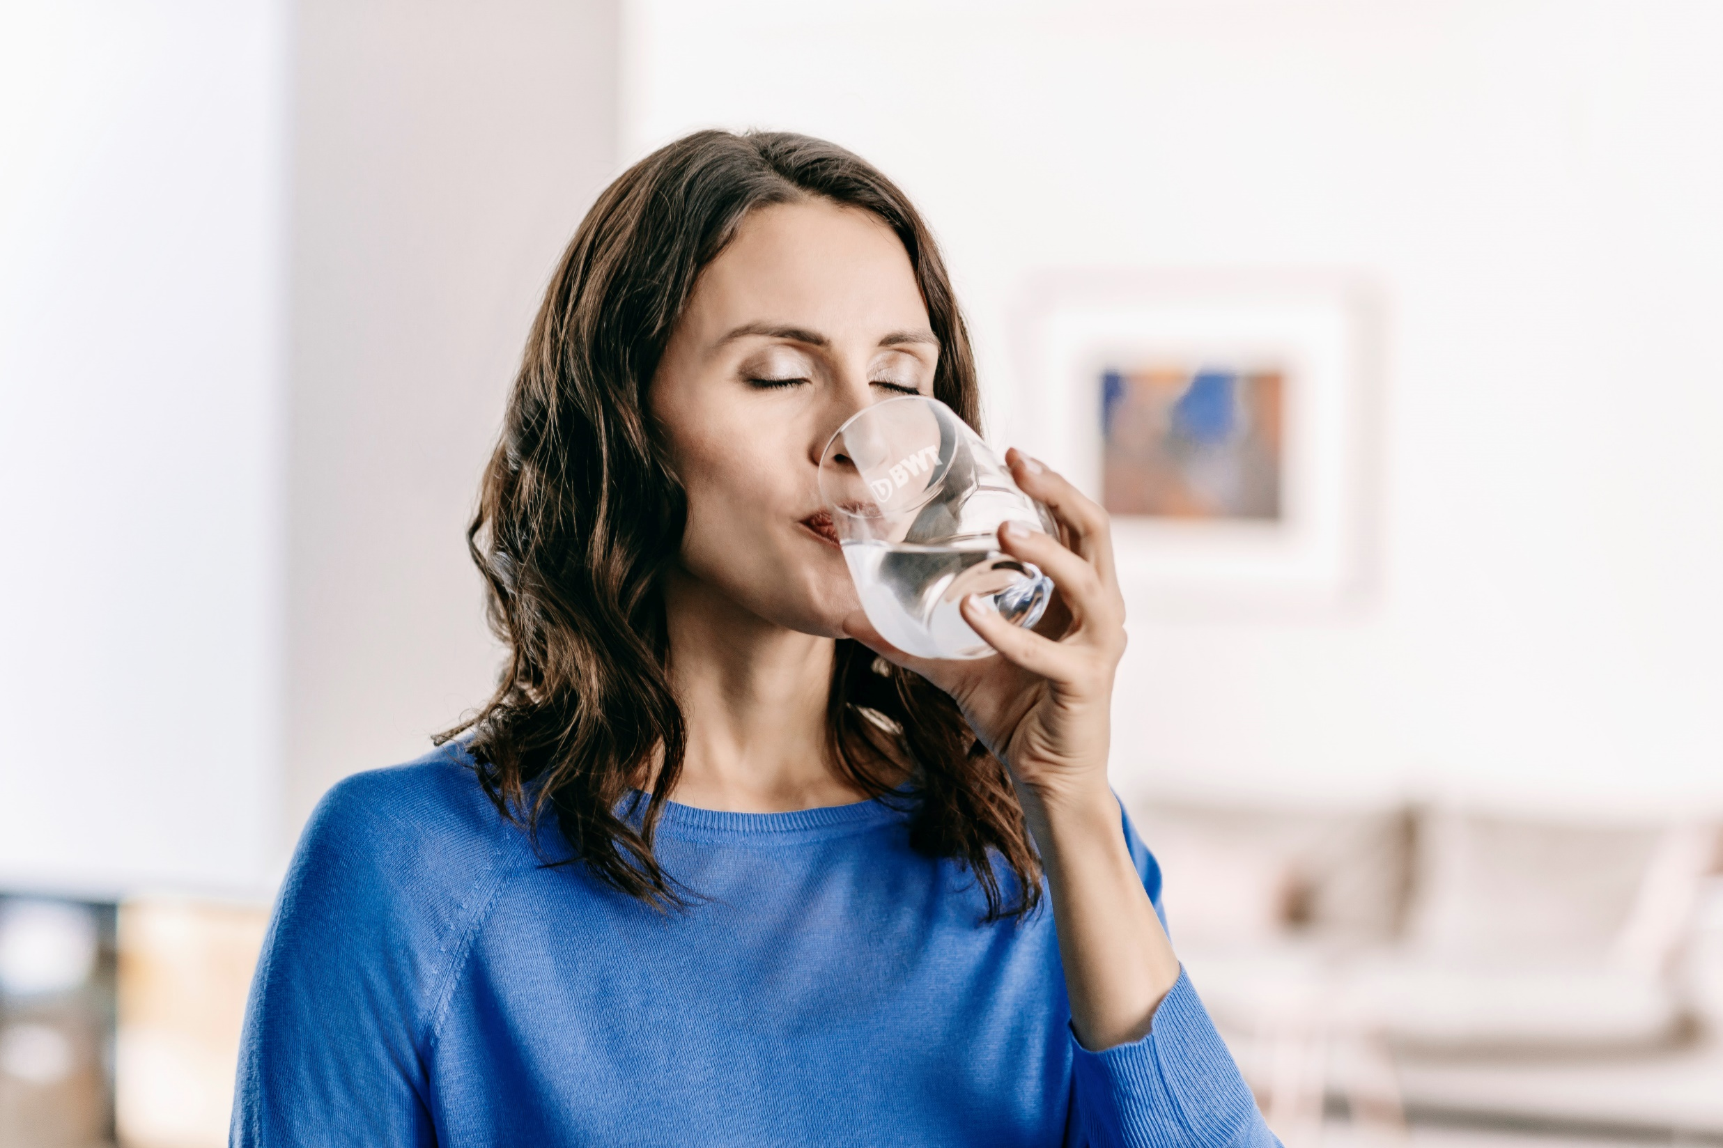

Slide 30
Thank you !

